Slide 1

SCM 649 Final Project Review
Modelling Popular Music

Slide 2

Team:
Jessica Martinez
Mohammed Saad
Swapnil Nikam
Scott Murray

Slide 3

Visualizing the data
After importing the data into JMP and performing some basic statistics to discover correlations between the attributes – we wanted to create visualizations to review the data even further.
We imported the data into Tableau and published a dashboard using their public reporting services.
Dynamic Visuals
Top Artists
Top Genres
Top Songs
Demographic Aggregations

Slide 4
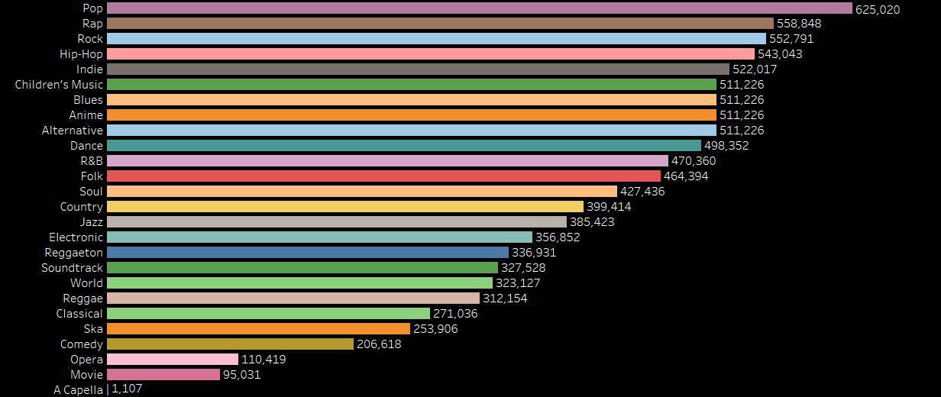
Top Genres

Slide 5
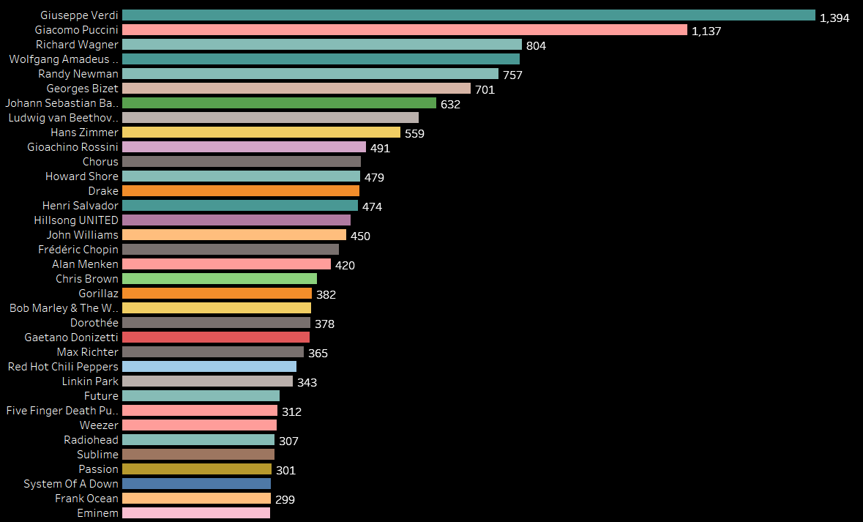
Top Artists

Slide 6
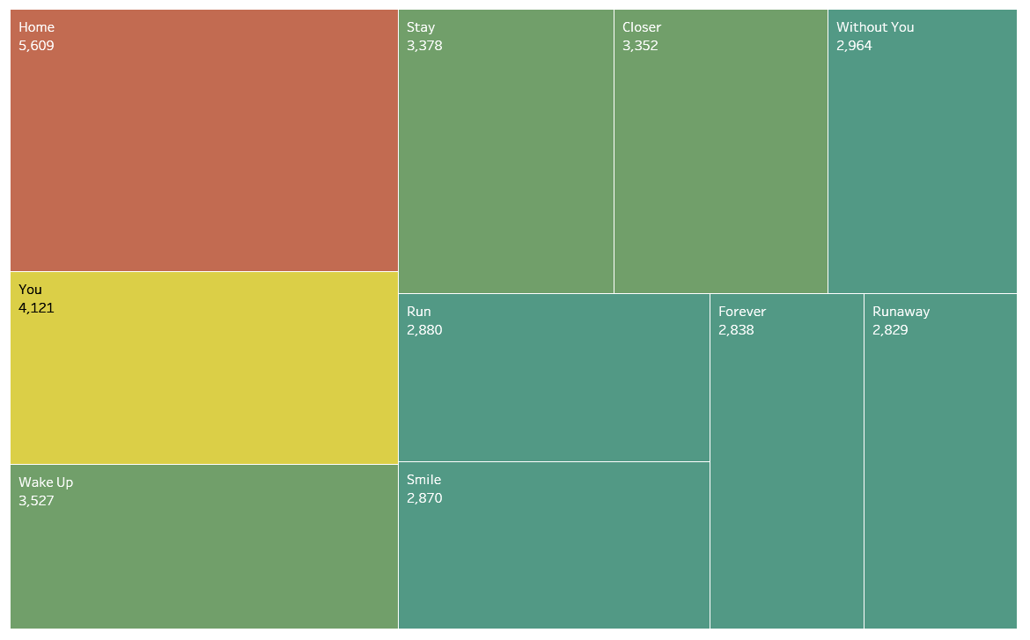
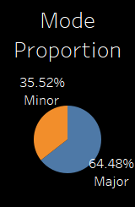
Top Songs and Mode

Slide 7
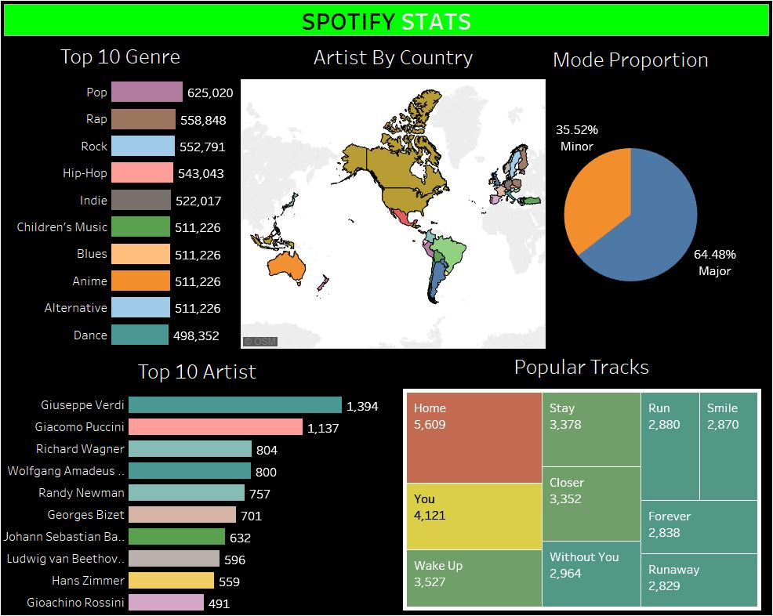
Tableau Dashboard
Top Genre
Top Artist (By Country)
Popularity by Mode
Popular Tracks
Online Dashboard

Slide 8
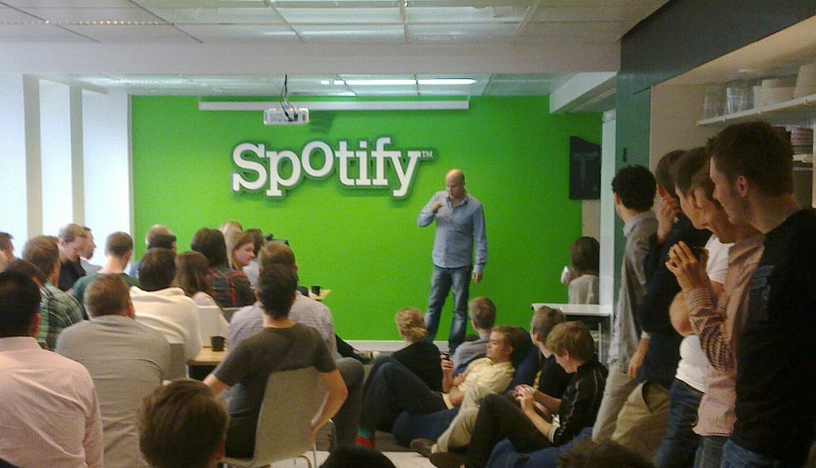




Thank You Questions?

